Slide 1
The Role of Microfinance in Aiding Refugees
8th Islamic Microfinance Forum
Dubai, November 2018

Slide 2
The Situation
as of June 2017

Slide 3
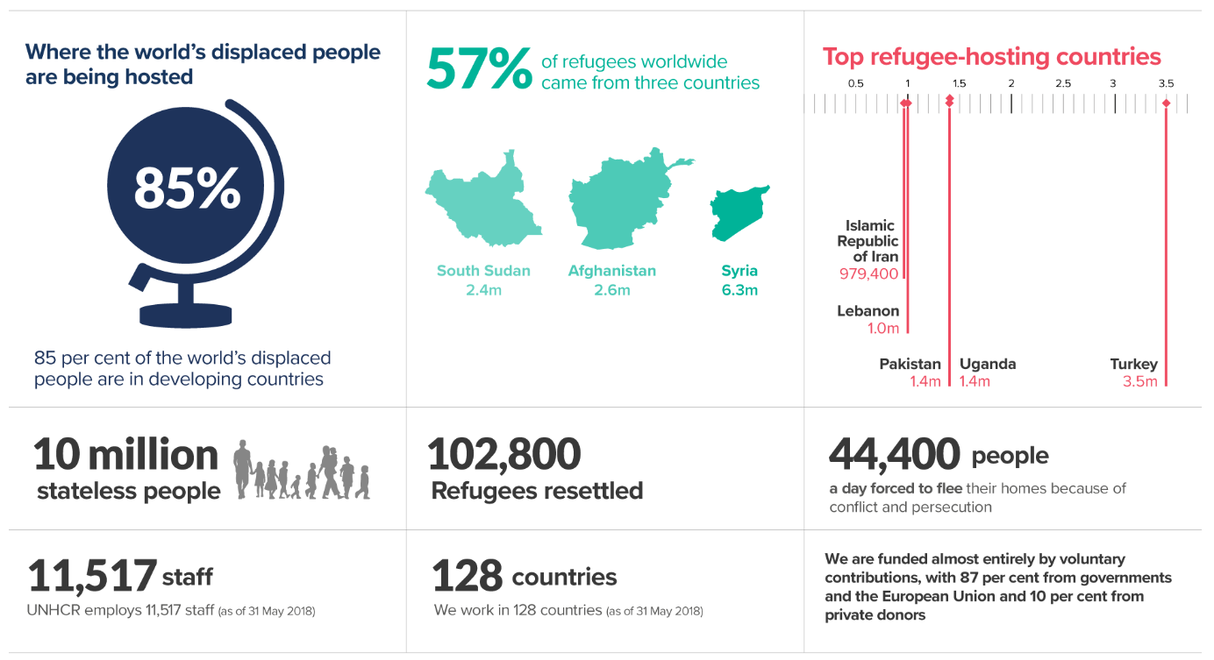
as of June 2017

Slide 4
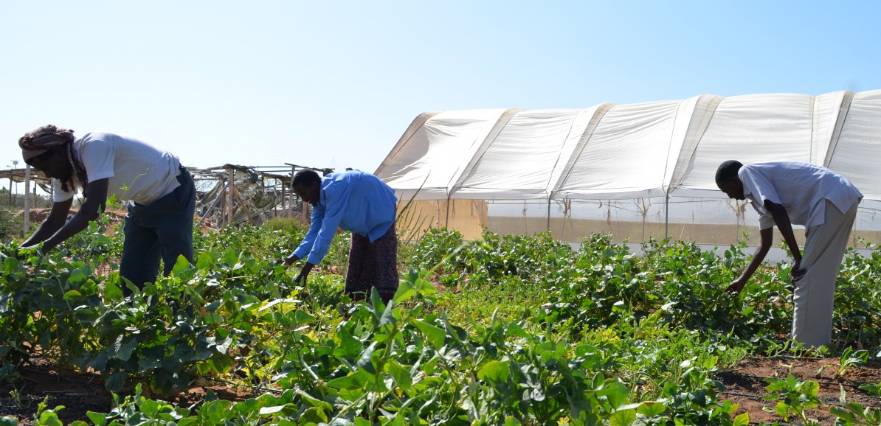
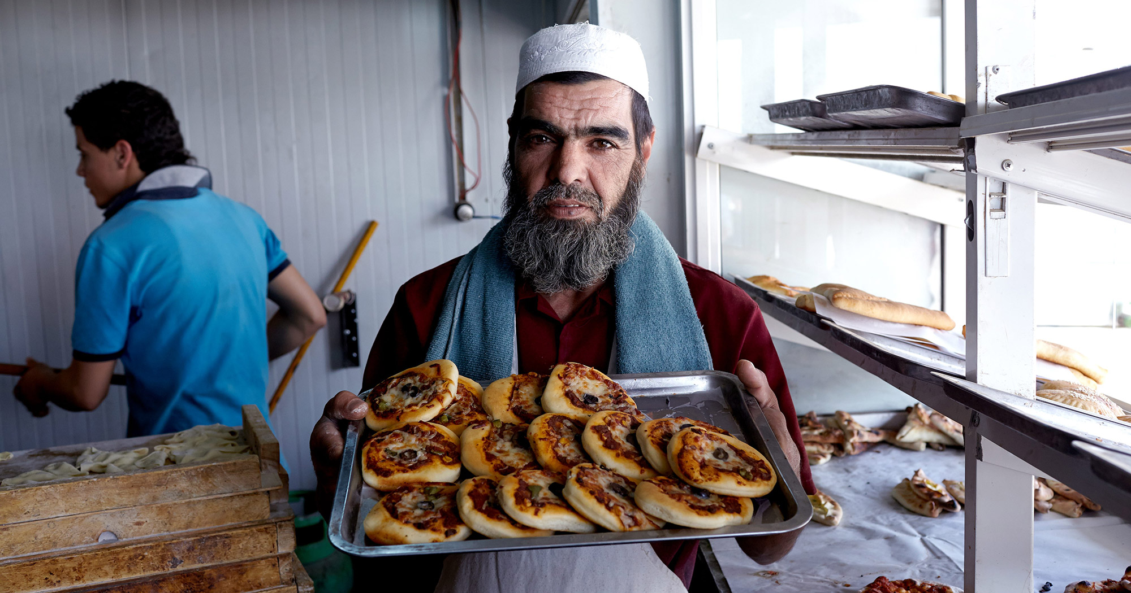
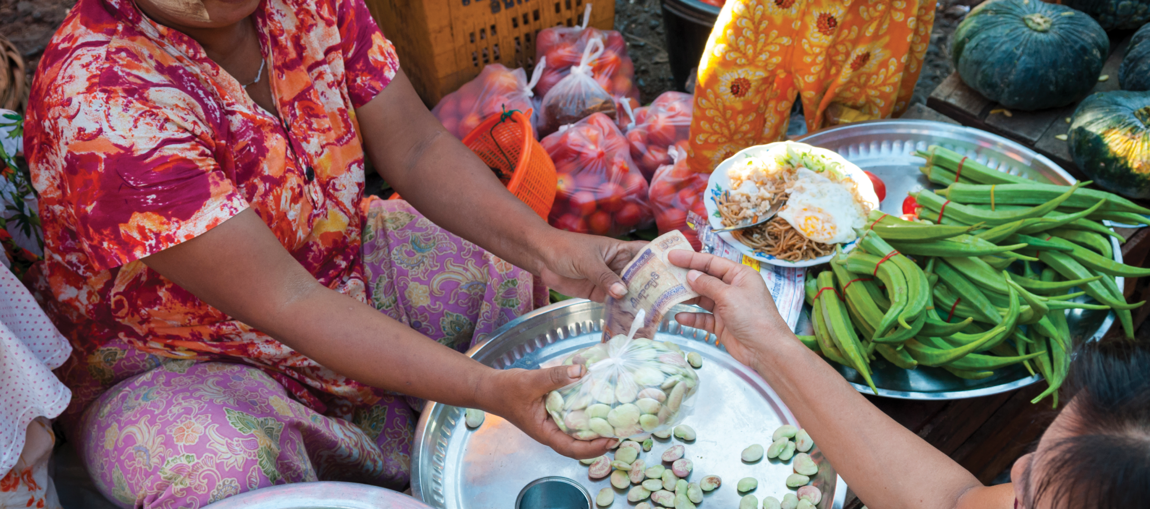
UNHCR’s Refugee Livelihoods and Economic Inclusion Strategy 2019-2023

Slide 5
Economic Inclusion for Refugees - Why?
The reduction of dependency through economic empowerment and the promotion of self-reliance is at the heart of UNHCR’s core mandate to protect and promote durable solutions for Persons of Concern (PoCs)
Economic inclusion entails access to labour markets, finance, entrepreneurship and economic opportunities for all, including non-citizens in addition to vulnerable and underserved groups
UNHCR recognises that access to financial capital is a vital element in the pursuit of self-reliance for refugees and highlights the crucial role of micro-finance in providing access to credit and loans for refugees, who are usually excluded from mainstream financial services
Under certain conditions, microfinance, if well planned, is one of the tools that can contribute to the enhancement of the capacity of PoC, particularly women who represent 70% of microfinance clientele worldwide, to generate income and improve their standards of living

Slide 6
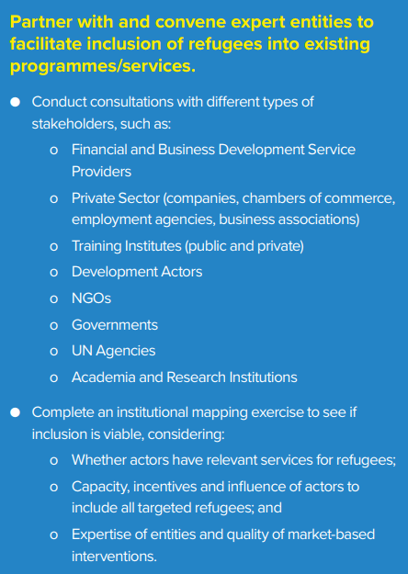
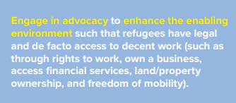
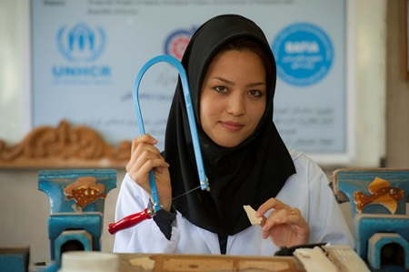
Economic Inclusion for Refugees - How?

Slide 7
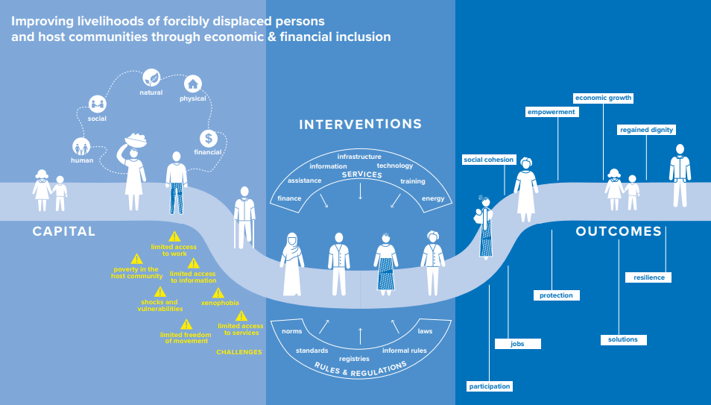
Economic Inclusion for Refugees - Impact

Slide 8
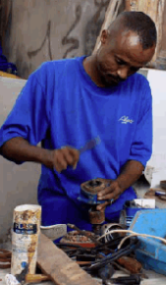
Economic Inclusion for Refugees – Microfinance Activities
Many refugees are entrepreneurs, having been business owners in their country of origin or having entrepreneurial skills to start or expand a business activity in their host country.
At UNHCR, we are committed to helping refugee entrepreneurs and business owners to develop new livelihoods or re-start enterprises in their countries of residence.
Microfinance can help build the financial capital of refugee households, to expand their livelihood opportunities and support their socio-economic wellbeing.
Start-up grants (short-term): start-up capital is critical for refugees who establish enterprises. They are provided where access to loans and other financial services is limited. The grant may be in the form of a productive asset or, where possible, is given in cash. Grants are provided based on the viability of the business plan the refugees have developed.
Financial inclusion (medium to long-term): microfinance projects aim to facilitate and promote sustainable access to services provided by microfinance institutions (savings, credits, transfers, micro-insurance).

Slide 9
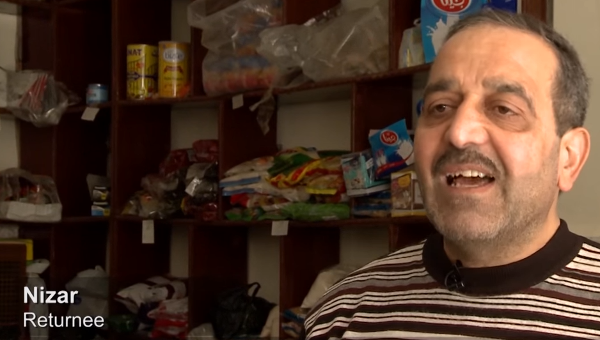
Microfinance Activities – Start-up Grants (Syria)
Momena
Palestinian-Syrian IDP in Syria
UNHCR’s Small Business Grants Programme gave a second chance to thousands of displaced people within Syria.
Enabling them to open businesses ranging from hairdressing salons like Momena’s to grocery stores and vehicle repair workshops.
The story of Momena: a friend of hers mentioned a programme offered by Al Nada Association, a Damascus-based nonprofit that partners with UNHCR, to provide start-up grants of up to $1,500 for small businesses.
After setting out her business plan with association staff, the seed money they provided allowed her to set up a small salon in Damascus. She now has a barber’s chair, a counter to set out her rollers and hair products, and there is even a television for her clients to watch.
The story of Nizar: returned to Homs in 2016 to find his shop at the souk still standing, he applied to the Small Business Grants Programme to re-open his grocery shop. https://www.youtube.com/watch?v=BQxWjFDrs18
Nizar
Syrian trader from Homs

Slide 10
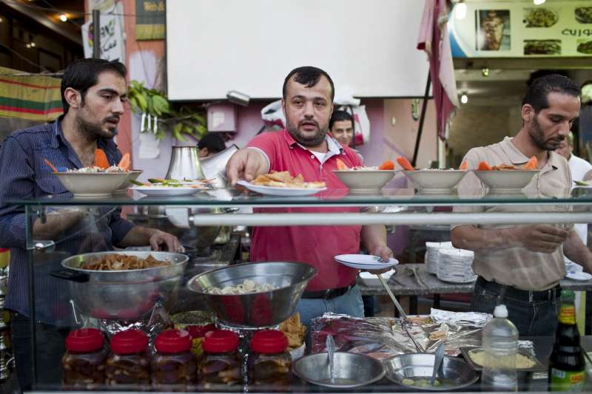
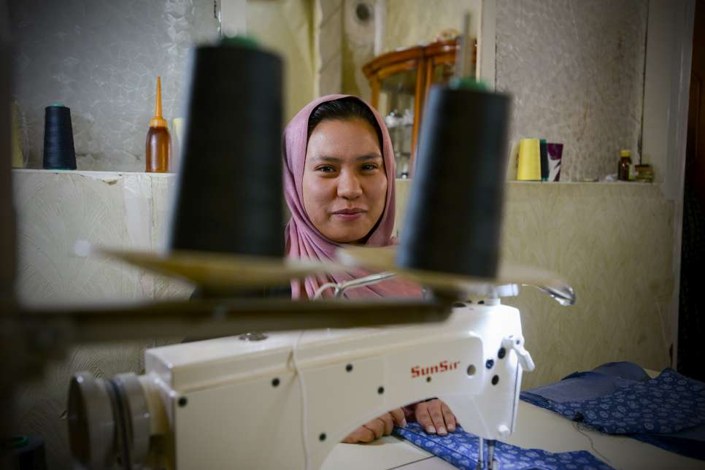
Microfinance Activities – Financial Inclusion/ Access to FSPs
UNHCR has been making special efforts to bring refugees and FSPs together. Through engaging workshops in Tunisia, Lebanon, Jordan, Morocco and Albania, FSPs had the chance to conduct preliminary financial needs assessments of refugees in their cities. By the end of the assessments most of the providers noted that engaging directly with refugees helped them to change their perception of refugees from that of a risky segment to a potential creditworthy clientele.
Among the pioneer FSPs lending to refugees, Al Majmoua is recording the highest outreach in the market, with exceptional repayment rates. As of the end of April, the Lebanese microfinance institution (MFI) was serving 8,520 Syrian refugee clients through both individual and group lending methodology.
Another MFI in Jordan, Microfund for Women (MFW), at the end of May has also achieved an impressive portfolio of 4,047 Syrian refugee borrowers, served through group lending methodology. And next month, MFW will also begin disbursing start-up business loans and educational loans to Syrians.
The Tunisian MFI Enda Tamweel, has already set up a pilot with a number of refugee entrepreneurs in Tunis, and is now preparing a second pilot phase in the Sahel area. The MFI will also accompany some refugees as they start up their businesses through a program for new entrepreneurs.

Slide 11
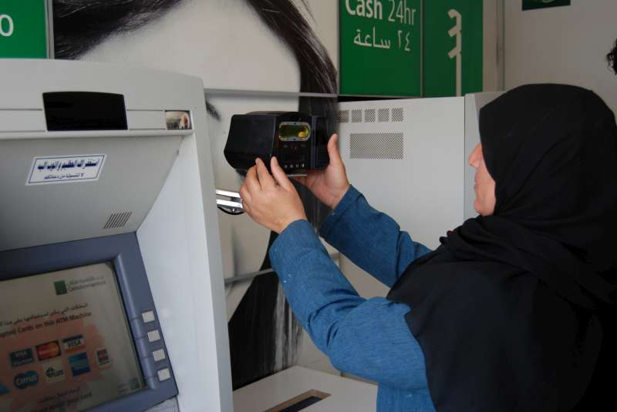
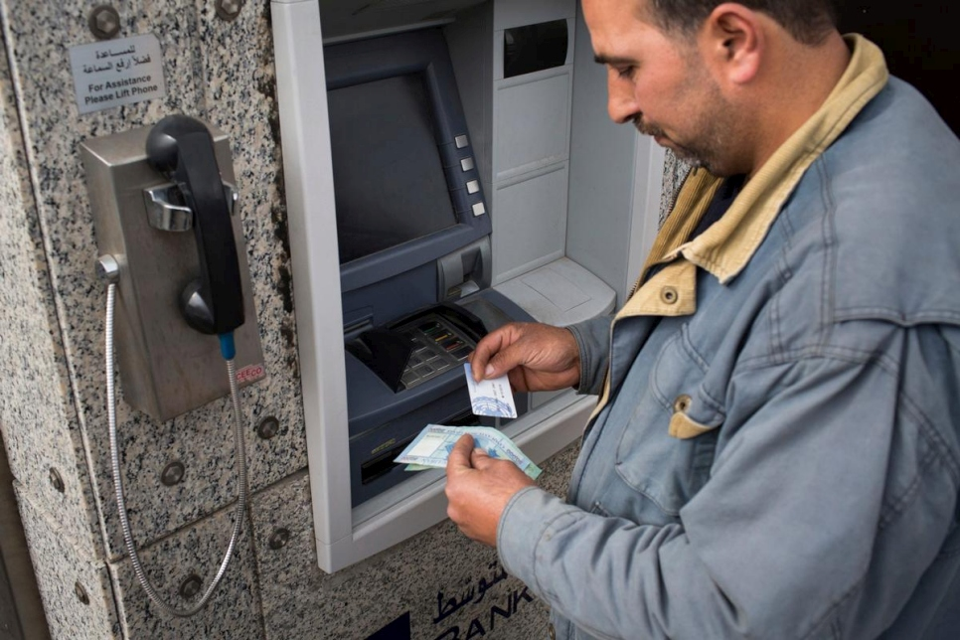
Alternatives to Microfinance – Cash Assistance
Cash-Based Initiatives create livelihoods opportunities
One of the most powerful aspects of creating a more enabling environment for refugee economic inclusion lies within the remits of UNHCR’s and host governments’ responsibilities– namely shifting from in-kind distribution of products and services to the provision of cash based interventions (CBIs) instead.
Particularly in operations where livelihoods opportunities are limited, CBIs can be used in a variety of settings, as long as there is a stable and functioning market and a safe way to provide refugees with cash or vouchers.
The flexibility that CBIs offers provides a more dignified form of assistance, giving refugees the ability to prioritise and choose what they need and boost the local economy through purchases.
In 2018, UNHCR launched its Zakat Programme, aiming to channel 100% of Zakat funds from individuals and Islamic financial institutions to most vulnerable refugee families through CBIs in Jordan and Lebanon.

Slide 12
Zakat is an Alternative Form of Assistance
Through cash assistance, UNHCR indirectly promotes livelihoods and helps refugees start up income generating activities, and prepare refugees to qualify for microfinance support in the future.
Through its Zakat initiative, UNHCR provides an efficient, trusted and discreet route to ensure 100% of Zakat contributions go directly to refugee households that are most in need.
UNHCR’s Zakat initiative is fully Shariah-compliant and is backed by fatwas from leading institutions and scholars.

Slide 13
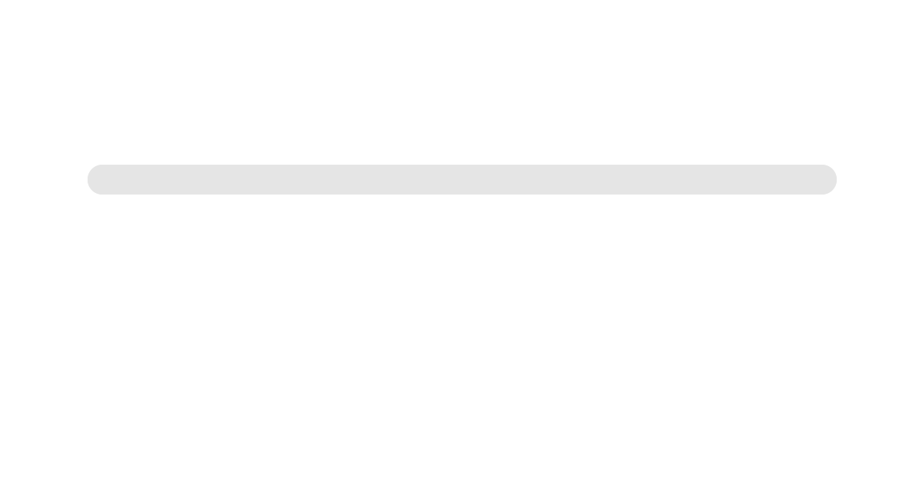
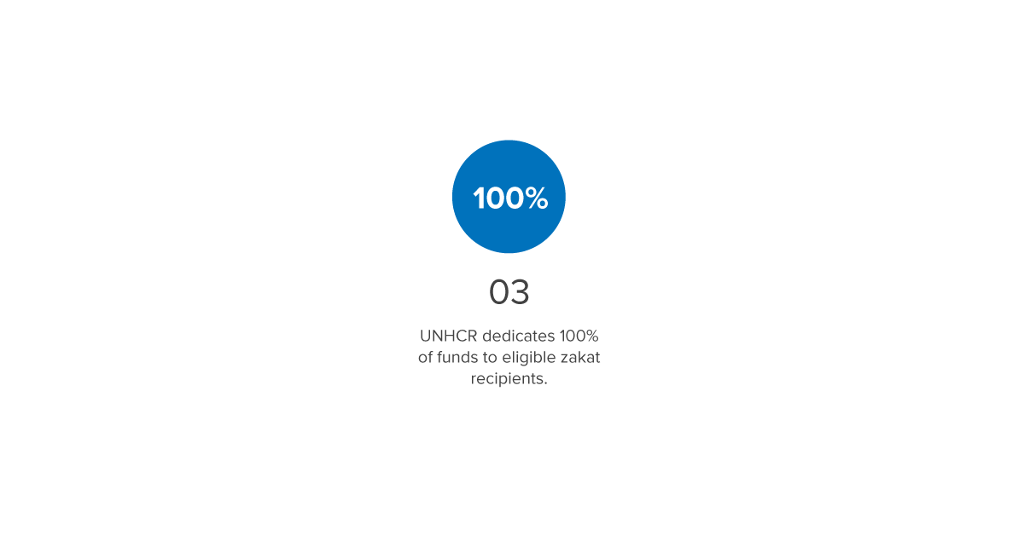

Slide 14
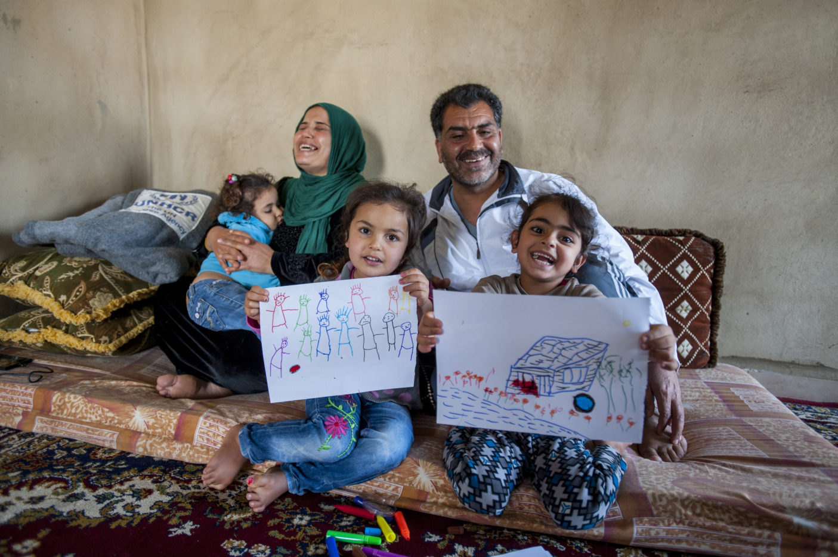
Thank you – Questions?

